Slide 1


Useful Documentation March 24
For HYPN/MHLs in School
Public Health – Children, Young People and Families

Slide 2
Healthy Young People’s Network 25 April 1-4pm – Hedgerows Family Centre
Full agenda to follow shortly, this session will include a specific engagement session around the New Physical Activity Strategy. This will be a face to face session, but a teams link is available within in case you are unable to make it in person but still want to be involved.
*Urban Foresight are working with Milton Keynes City Council to inform the development of the new Physical Activity Strategy. Central to developing the strategy is a need to take a whole systems approach, understanding how those who may not conventionally work within the physical activity sector can input and work together with others across Milton Keynes.
We're holding a series of sector specific engagement sessions. As part of this, we're looking to engage those who work with early years settings, schools, colleges and young people more generally to understand how educational attainment, physical literacy, tackling inequalities, fostering inclusion, school readiness and emotional wellbeing link with physical activity.

Slide 3
HYPN April 25 1-4pm
To achieve this, we'll be spending some time throughout the session:
Exploring what we mean by a whole systems approach to physical activity
Understanding how you see your current position in the system
Exploring how we can get Milton Keynes moving: Strengths and hopes for the future
Sharing models of best practice
Exploring opportunities, barriers and prioritising solutions
Moving forwards: learning how to stay involved and creating a community of practice
Contact liz.wilson@milton-keynes.gov.uk to book your place.

Slide 4
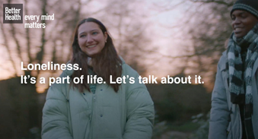
Better Health
Every Mind Matters
The Department for Culture, Media and Sport has launched the next phase of the Better Health – Every Mind Matters campaign. Targeted at 16 – 24-year-olds, one of the most at risk audience groups, the campaign aims to reduce the stigma of loneliness, increase knowledge of where to find support and encourage taking action.
Loneliness. It's a part of life. Let's talk about it.
We're all affected by loneliness at times in our lives. We can feel lonely in a busy city or rural location, on social media or spending time on our own or with others. Try not to feel embarrassed or ashamed if you do.
Sometimes admitting we feel lonely can be hard. It’s important to remember that lots of people experience similar feelings of loneliness, and that they can pass. Understanding our own reasons for feeling lonely can help identify and manage these feelings.
Find out about possible signs of loneliness, reasons we feel lonely and ways to manage it. There are also links to more support if you or someone else needs it. What is loneliness? Signs or symptoms of loneliness What causes loneliness? Loneliness at university Tips on dealing with loneliness More help and support for loneliness Loneliness - Every Mind Matters - NHS (www.nhs.uk)

Slide 5

British Deaf Association
Sign Language Week
Promoting BSL & ISL 18 – 24 March 2024
Sign Language Week 2024 T... - Milton Keynes SEND IAS
Further resources - Home SLW 2024 BU - Sign Language Week

Slide 6
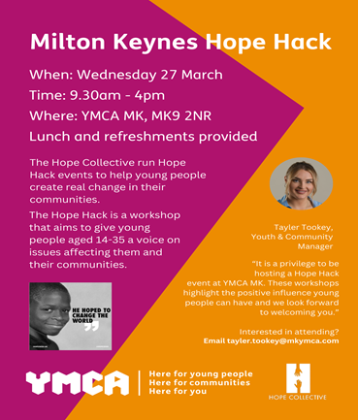
Milton Keynes
Hope Hack
Events

Slide 7
Milton Keynes
City Council
SEND Local Offer
Milton Keynes City Council (mksendlocaloffer.co.uk)
Useful resources
Ideas, strategies and resources to help children and young people with SEND. Useful resources | Milton Keynes City Council (mksendlocaloffer.co.uk)
SEND directory information | Milton Keynes City Council (mksendlocaloffer.co.uk)
https://www.mksendlocaloffer.co.uk/what-send-team-does/send-local-offer-privacy-notice

Slide 8
Ofsted launches ‘Big listen’
Ofsted launches ‘Big Listen’ consultation to hear from parents and professionals. TheOffice for Standards in Education, Children’s Services and Skills (Ofsted) has today (8 March) launched a ‘Big Listen’ consultation, to hear from the full range of professionals and providers Ofsted works with, as well as the parents, carers, children and learners it works for. The consultation asks a series of questions to help shape the conversation and provide a sense of direction for the changes Ofsted could make. Ofsted will launch a strand of the consultation specifically aimed at children, including those in the care system, later this month. The consultation opens today and will run for 12 weeks & closes 31 May.

Slide 9
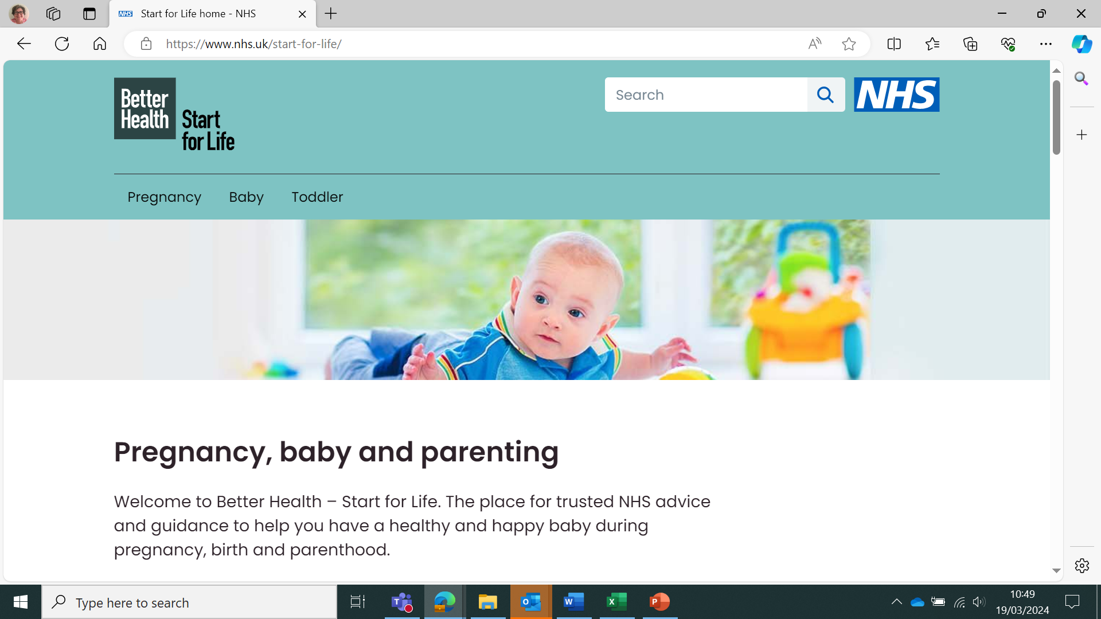
Start for life
Start for Life home - NHS (www.nhs.uk) Pregnancy, baby and parenting. Better Health – Start for Life. The place for trusted NHS advice and guidance to help you have a healthy and happy baby during pregnancy, birth and parenthood.

